Slide 1

Investment opportunities in poor neighbourhoods in King County, Washington
Presentation for Erin Robinson
11.08.2023

Slide 2

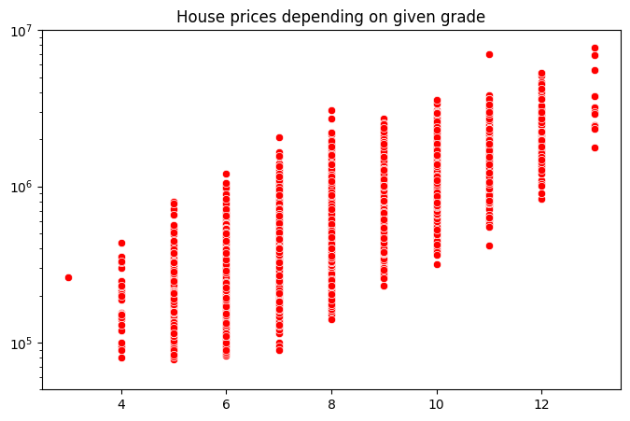
All available properties:
10 million
Price
1 million
100 k
1
Grade

Slide 3
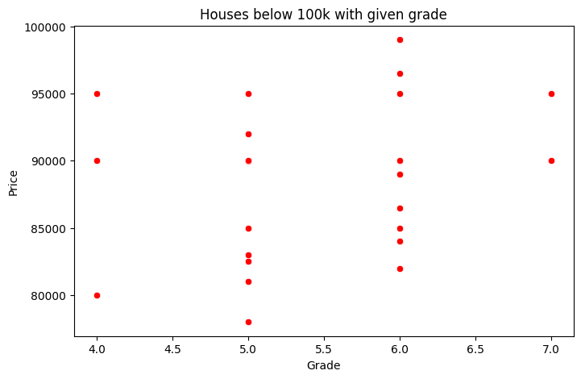

24 houses below 100 k:
Price
Grade
2

Slide 4
24 houses below 100 k:
Price
85 k
7 houses below 85 k
Grade
3

Slide 5
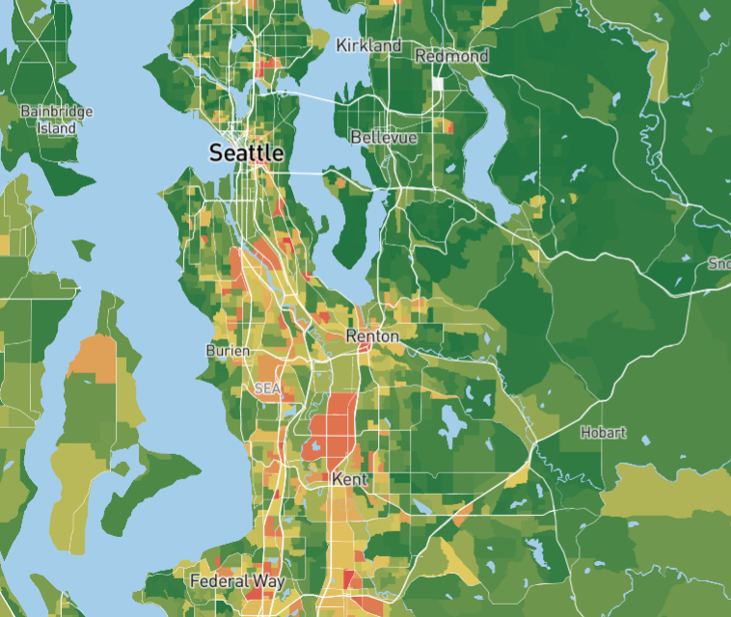
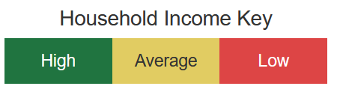
Poor neighbourhoods in King County:
4
https://bestneighborhood.org/household-income-king-county-wa/

Slide 6
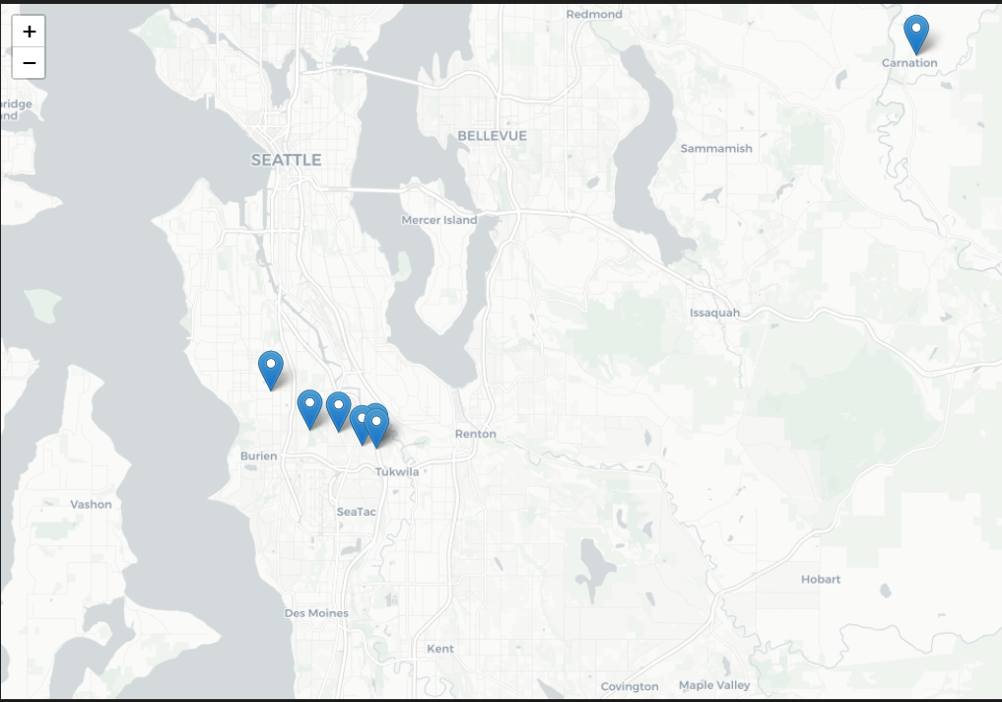
Locations of 7 houses below 85 k:
5

Slide 7
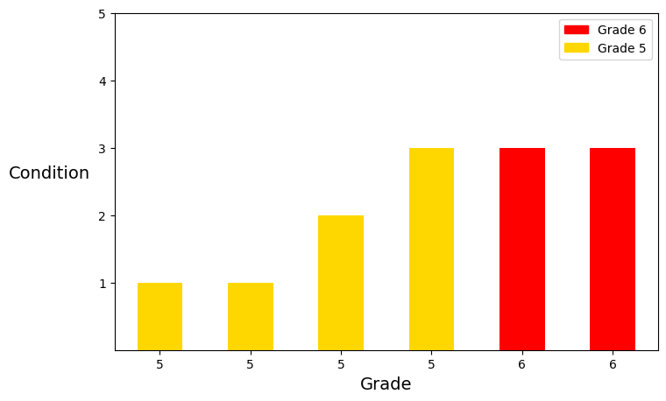
Conditions of 6 houses in poor neighbourhood below 85 k:
6

Slide 8
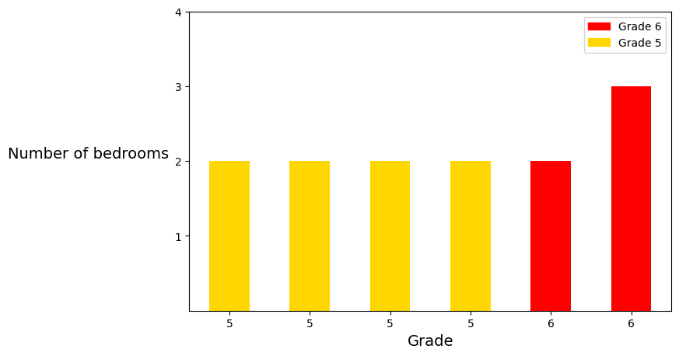
Number of bedrooms of 6 houses in poor neighbourhood below 85 k:
7

Slide 9
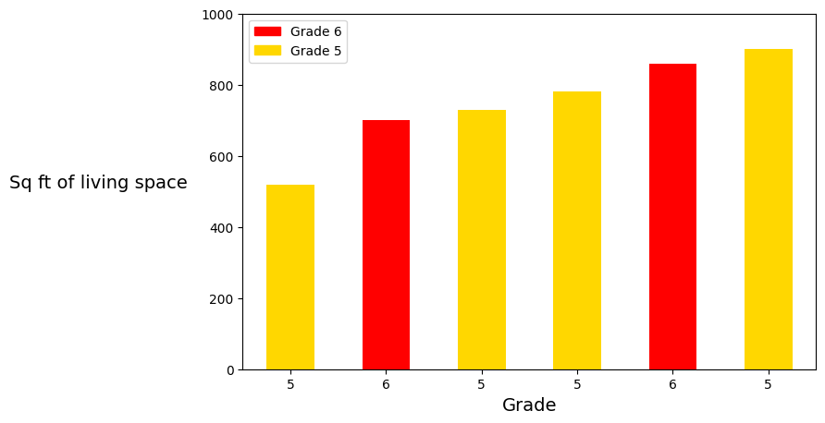
Sq ft of living space of 6 houses in poor neighbourhood below 85 k:
8

Slide 10
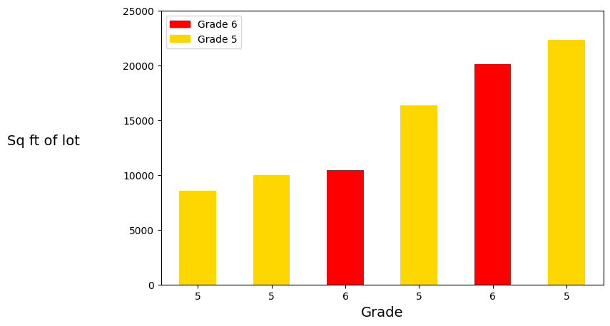
Sq ft of lot of 6 houses in poor neighbourhood below 85 k:
9

Slide 11

Thank you for your attention!

